Slide 1
RECURSION
A problem solving paradigm

Slide 2

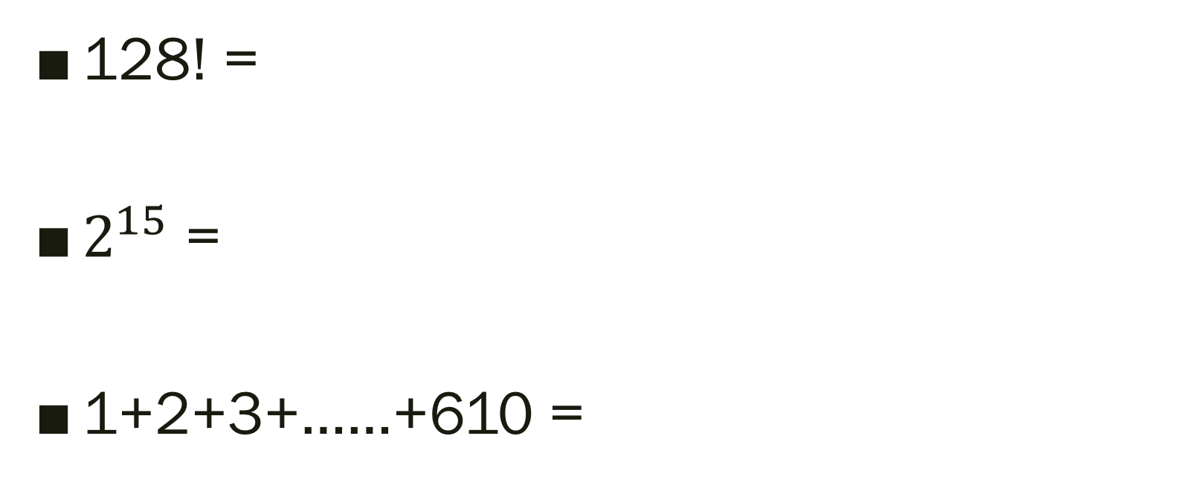
Please evaluate these by hand !

Slide 3

Exhausting? Looking for an easier way?
Simply do your part and let the next person figure it out.
Just act at your own minimal processing capacity!
Notes:
Illustration point

Slide 4
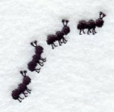
Let ants calculate this simpler version: 4!
1!
4th ant: 4! = 4*3! (3! Passed to the 3rd ant in line)
3rd ant: 3! = 3*2! ( 2! Passed to the 2nd ant)
2nd ant : 2! = 2*1! (1! Passed to the first ant)
1st ant : 1! =1
Lets propagate back!
Lets not forget about priorities in line.
2!
3!
4!

Slide 5
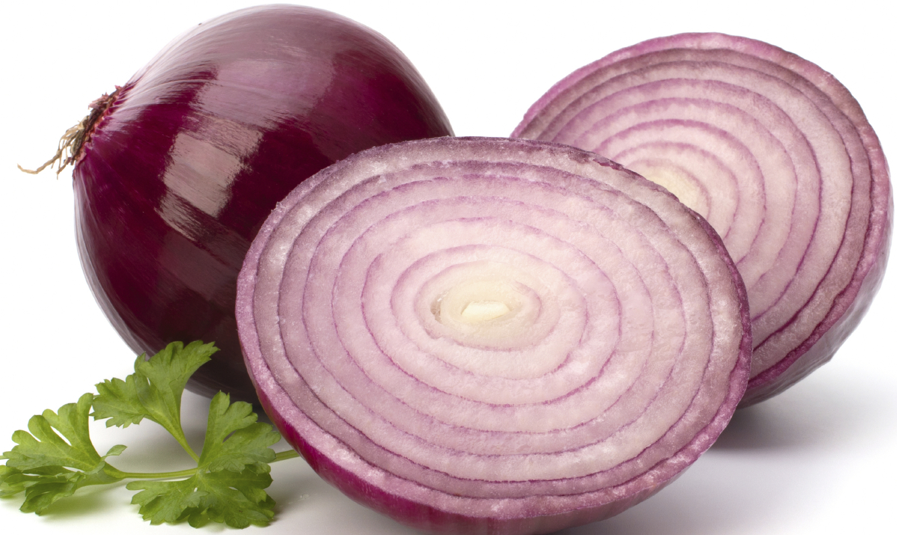
Recursive functions in java (+ Onion model)
A Function calls itself with a smaller argument which is easier to figure out.
Each simpler version is the next one in line.
Fact(4) = 4 * Fact(3)
Fact (3) = 3* Fact(2)
Fact (2) = 2*Fact(1)
Fact(1) = 1

Slide 6

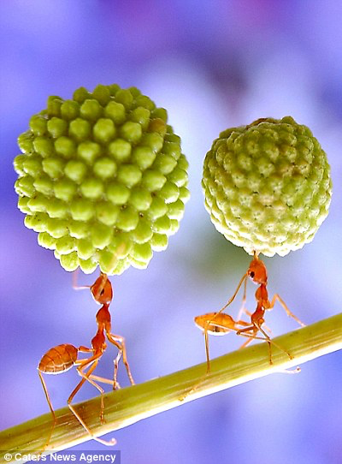
Base case and Recursive case
Base case : simplest possible calculation on earth that can be done for your problem( in other words, the luckiest person in the front of line who doesn’t have to bother at all because of first person in line privileges!)
Recursive case : every other step involved in calculation ( everyone else in the line except the first one, who all do the same exact amount of calculations, making it smaller a layer and passing along)

Slide 7
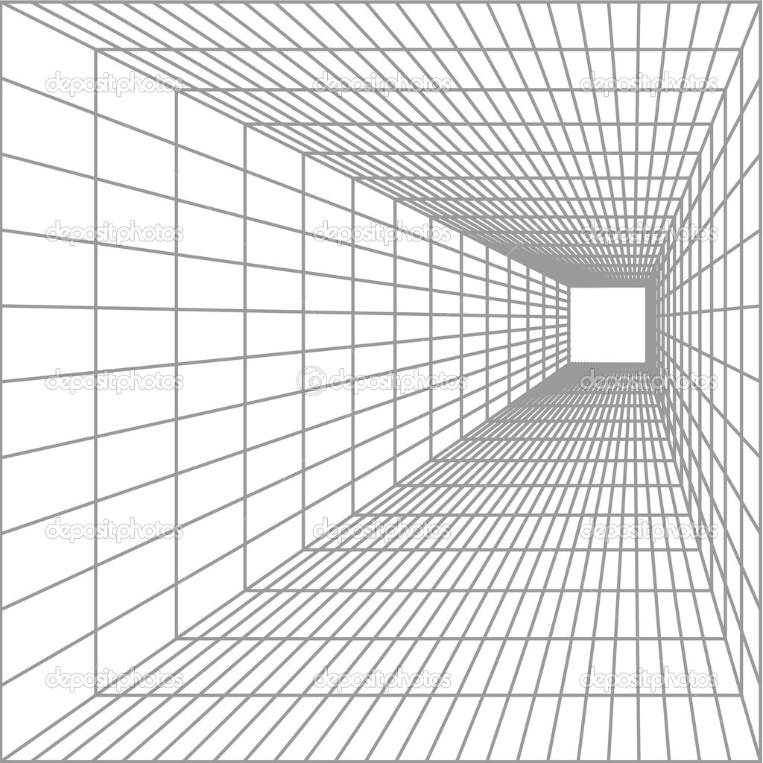
How java sees this (recursive version)
public static int factorial(int n) {
if (n == 1) return 1;
else return n * factorial(n - 1);
}

Slide 8

How java sees this (loop version)
public static int factorial(int n) {
int result = 1;
for (int i = 1; i <= n; i++) {
result *= i;
}
return result;
}

Slide 9

Why bother with recursion?
Elegant , beautiful cool code
Much more compact
Less declerations to make.
VS

Slide 10

How recursion is handled?
Each time a recursive function is called, a new copy of the function runs, with new instances of parameters and local variables being created
As each copy finishes executing, it returns to the copy of the function that called it
When the initial copy finishes executing, it returns to the part of the program that made the initial call to the function.

Slide 11
Fibonacci numbers
n: | 0 | 1 | 2 | 3 | 4 | 5 | 6 | 7 | 8 | 9 | 10 | 11 | …
nth Fibonacci: | 0 | 1 | 1 | 2 | 3 | 5 | 8 | 13 | 21 | 34 | 55 | 89 | …
public int fib(int n) {
if(n <= 1) {
return n;
} else {
return fib(n - 1) + fib(n - 2);
}
}

Slide 12
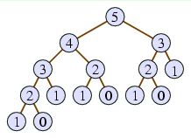
Fibonacci
Recursive calls tree :
int x = fib(5);

Slide 13
Let’s blowup the stack!
public class StackOverflow { public static void recursive(int num) { System.out.println(num); recursive(num+1); } public static void main(String[] args) { recursive(1); } }

Slide 14
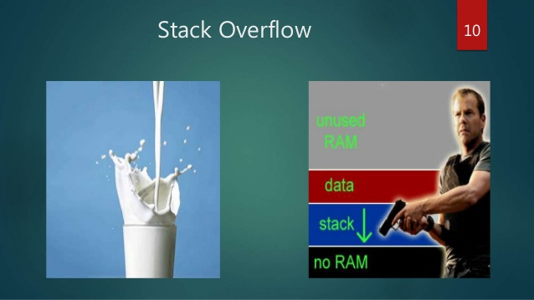
When does it happen?
you have no (correct) base cases, so you will never finish calling calling calling …
recursion chain is too big to fit in memory, so you may rethink about using recursion

Slide 15
A Recursive Binary Search Function
Assume an array a sorted in ascending order, and an item X
We want to write a function that searches for X within the array a, returning the index of X if it is found, and returning -1 if X is not in the array

Slide 16
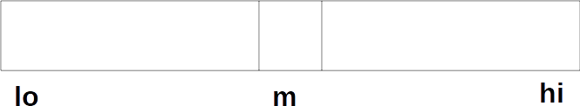
Recursive Binary Search
A recursive strategy for searching a portion of the array from lo to hi is to
set m to position of middle of portion of array:

Slide 17
Binary Search
If a[m] == X, we found X, so return m
If a[m] > X, recursively search a[lo..m-1]
If a[m] < X, recursively search a[m+1..hi]

Slide 18
Binary Search
int bSearch(int a[],int lo,int hi,int X)
{
int m = (lo + hi) /2;
if(lo > hi) return -1; // base
if(a[m] == X) return m; // base
if(a[m] > X)
return bsearch(a,lo,m-1,X);
else
return bsearch(a,m+1,hi,X);
}

